Slide 1
Fundamentals of
Information Technology
UNIT - I

Slide 2
Learning Objectives
  In this Unit we will discuss :
  Digital Signals and Logic gates
  Number systems:
    Binary,
    octal and hexadecimal number systems,
    signed binary number,
    binary arithmetic,
    2’s complement arithmetic
  Microprocessors:
    Introduction,
    System Bus,
    Architecture and operation of 8085 microprocessor and instruction set

Slide 3
Logic Gates
  Logic gates are electronic circuits that operate on
  one or more input signals to produce standard output signal
  Are the building blocks of all the circuits in a computer
  Some of the most basic and useful logic gates are
  AND, OR, NOT, NAND and NOR gates

Slide 4
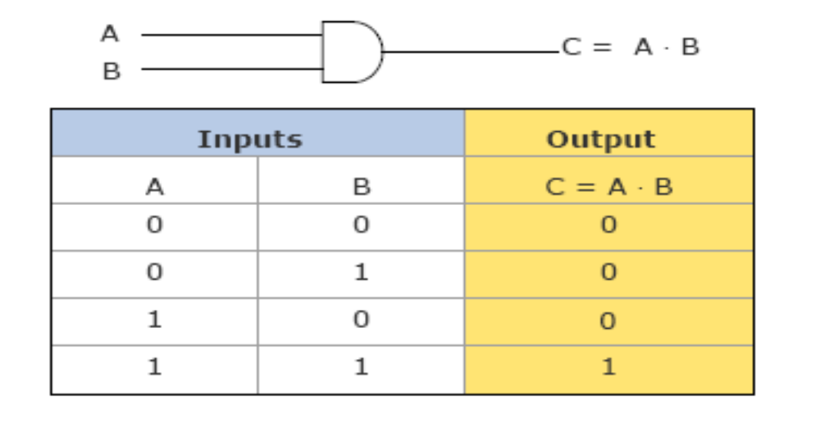
Logic Gates
AND Gate (Symbol and Truth Table)
Physical realization of logical multiplication (AND) operation
Generates an output signal of 1 only if all input signals are 1.

Slide 5
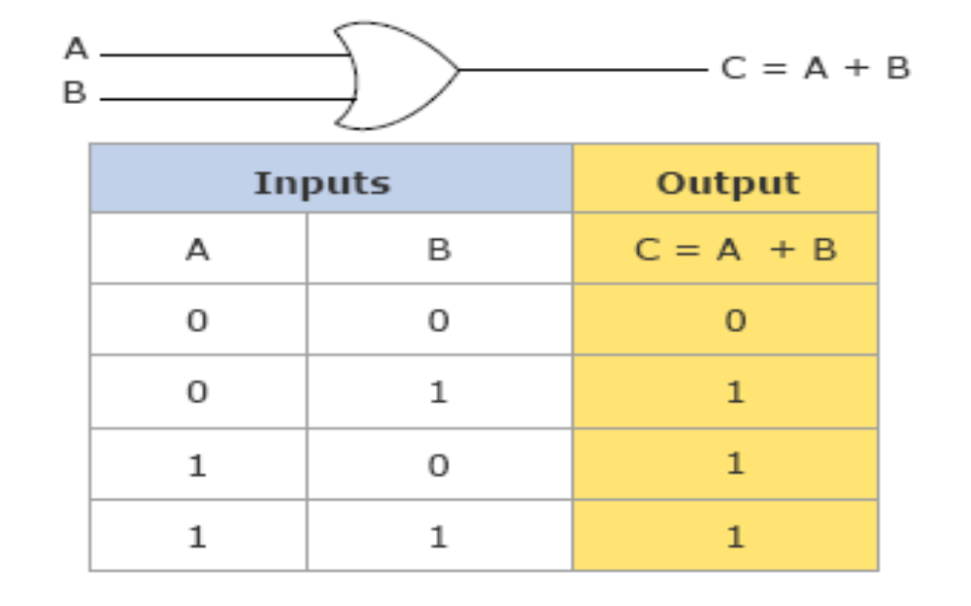
Logic Gates
OR Gate (Symbol and Truth Table)
Physical realization of logical addition (OR) operation
Generates an output signal of 1 if at least one of the input signals is 1.

Slide 6
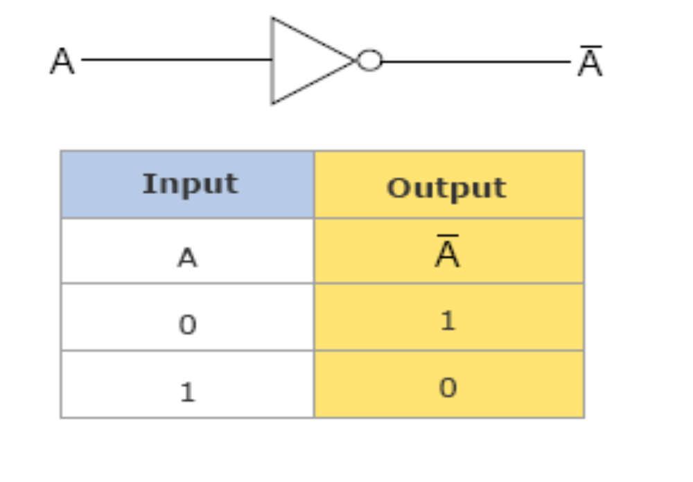
Logic Gates
NOT Gate
Physical realization of complementation operation.
Generates an output signal, which is the reverse of the input signal.

Slide 7
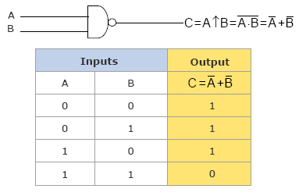
Logic Gates
NAND Gate
Complemented AND gate
Generates an output signal of:
  1 if any one of the inputs is a 0
  0 when all the inputs are 1

Slide 8
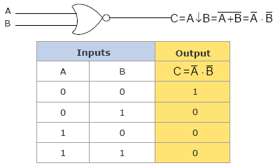
Logic Gates
NOR Gate
Complemented OR gate
Generates an output signal of:
  1 only when all inputs are 0
  0 if any one of inputs is a 1

Slide 9
Logic Gates
Logic Circuits
When logic gates are interconnected to form a gating /logic network, it is known as a combinational logic circuit
The Boolean algebra expression for a given logic circuit can be derived by systematically progressing from input to output on the gates
The three logic gates (AND, OR, and NOT) are logically complete because any Boolean expression can be realized as a logic circuit using only these three gates

Slide 10
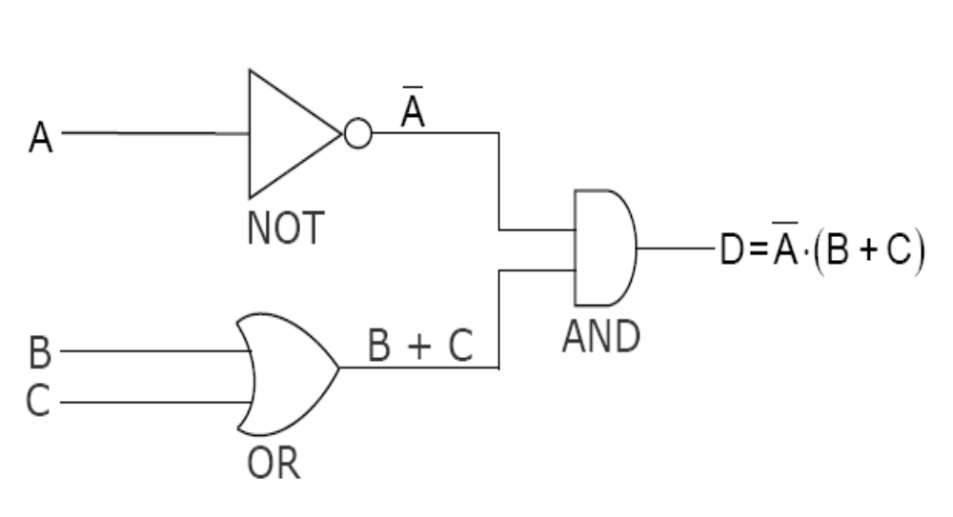
Logic Gates
Logic Circuits
Example1 for finding Boolean expression of a Logic Circuit

Slide 11
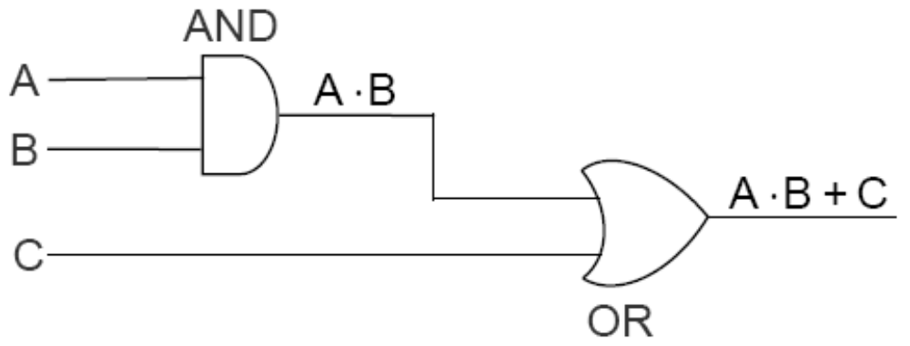
Logic Gates
Logic Circuits
Example1 for constructing Logic Circuit from a Boolean expression.

Slide 12
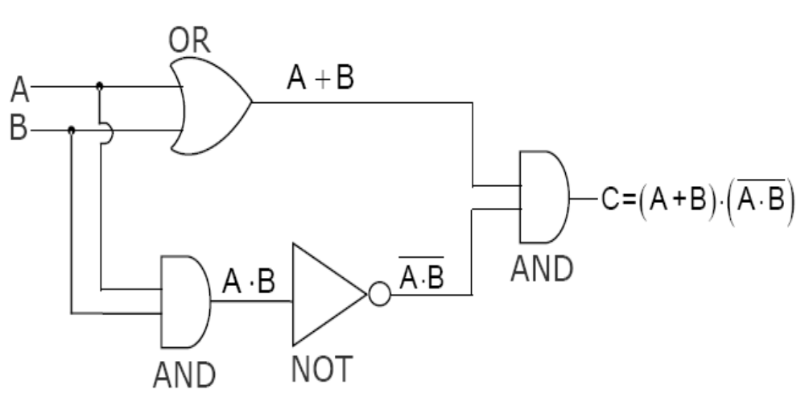
Logic Gates
Logic Circuits
Example2 for finding Boolean expression of a Logic Circuit

Slide 13
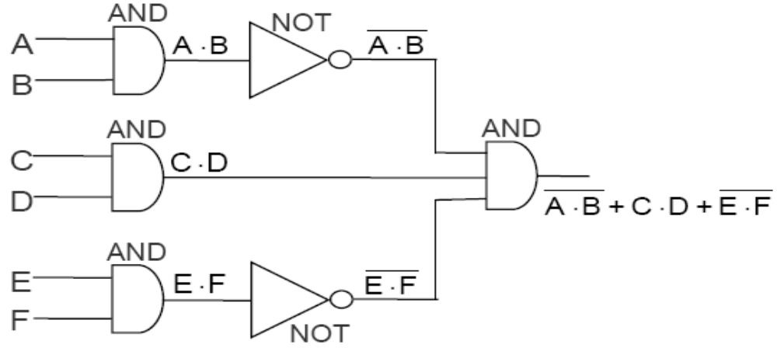
Logic Gates
Logic Circuits
Example2 for constructing Logic Circuit from a Boolean expression.

Slide 14
Basic Identities of Boolean Algebra
x+0=x x.0=0
x+1=1 x.1=x
x+x=x x.x=x
x+x’=1 x.x’=0
x(y+z)=xy+xz x+y.z=(x+y)(x+z)
(x+y)’=x’.y’ (xy)’=x’+y’

Slide 15
Logic Gates
Universal NAND Gate
NAND gate is an universal gate, it is alone sufficient to implement any Boolean expression.

Slide 16
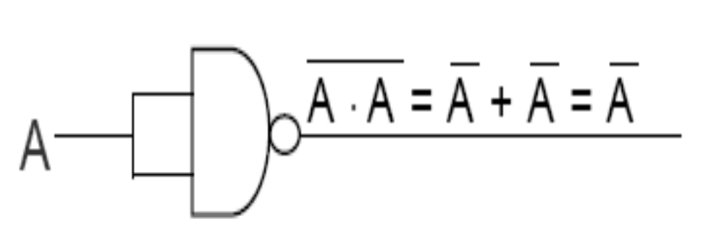
Logic Gates
Universal NAND Gate
Implementation of NOT Gates by NAND Gates

Slide 17
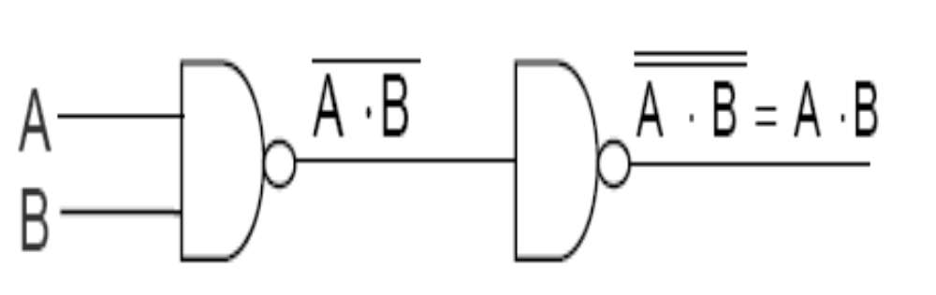
Logic Gates
Universal NAND Gate
Implementation of AND Gates by NAND Gates

Slide 18
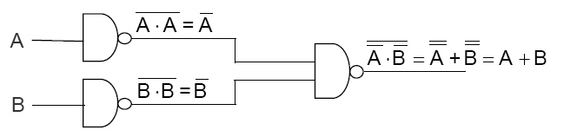
Logic Gates
Universal NAND Gate
Implementation of OR Gates by NAND Gates

Slide 19
Logic Gates
Method of Implementing a Boolean Expression
with Only NAND Gates
Step 1: From the given algebraic expression, draw the logic
diagram with AND, OR, and NOT gates. Assume that both the normal (A) and complement ( ) inputs are available
Step 2: Draw a second logic diagram with the equivalent NAND logic substituted for each AND, OR, and NOT gate
Step 3: Remove all pairs of cascaded inverters from the diagram as double inversion does not perform any logical function. Also remove inverters connected to single external inputs and complement the corresponding input variable

Slide 20
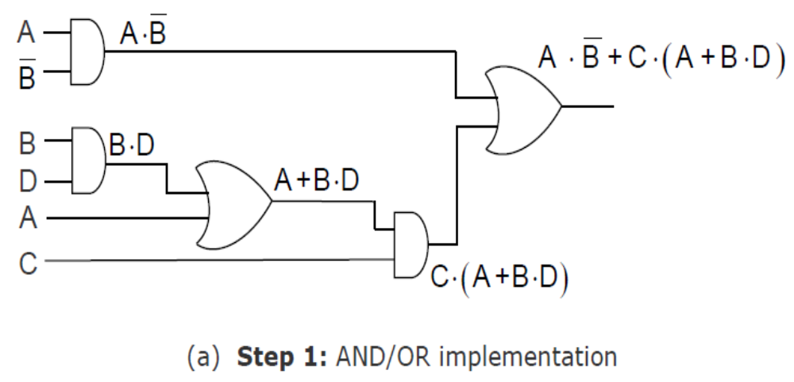
Logic Gates
Implementing a Boolean Expression with Only
NAND Gates (Example)

Slide 21
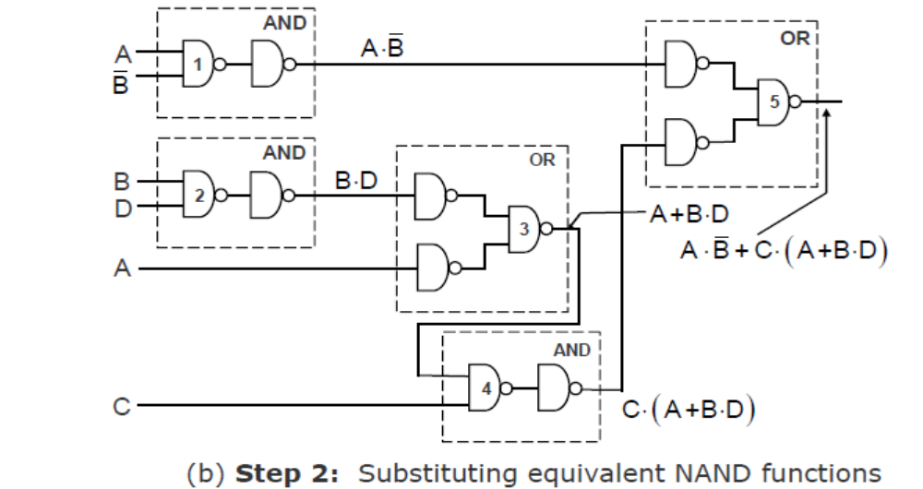
Logic Gates
Implementing a Boolean Expression with Only
NAND Gates (Example)

Slide 22
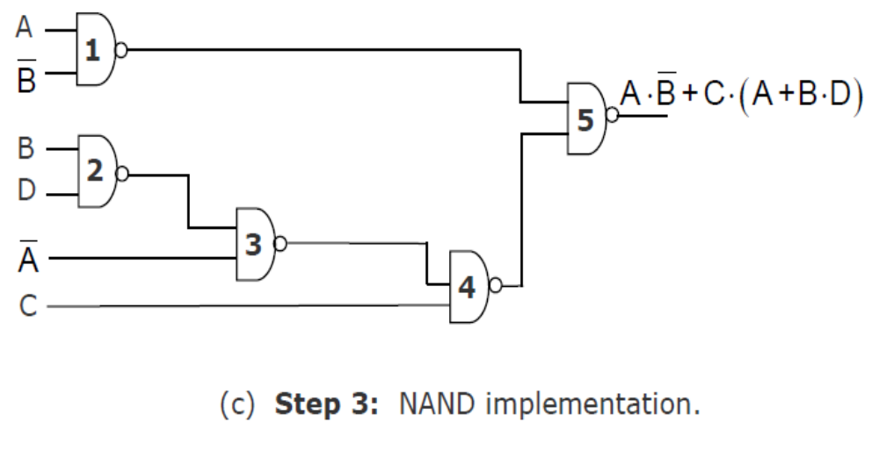
Logic Gates
Implementing a Boolean Expression with Only
NAND Gates (Example)

Slide 23
Logic Gates
Universal NOR Gate
NOR gate is an universal gate, it is alone sufficient to implement any Boolean expression.

Slide 24
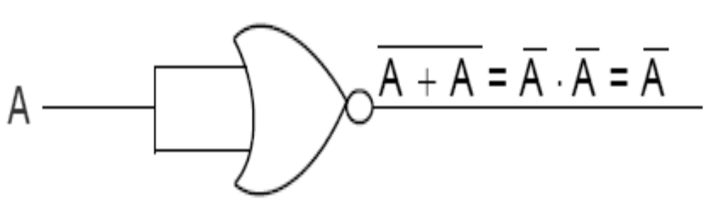
Logic Gates
Universal NOR Gate
Implementation of NOT Gates by NOR Gates

Slide 25
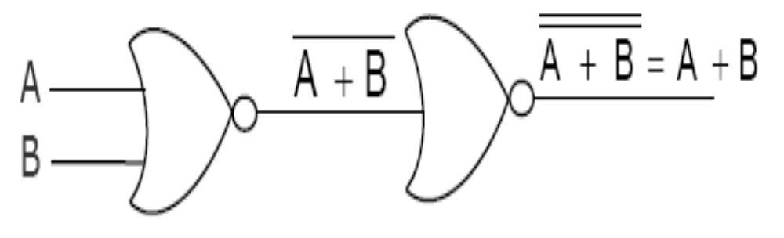
Logic Gates
Universal NOR Gate
Implementation of OR Gates by NOR Gates

Slide 26
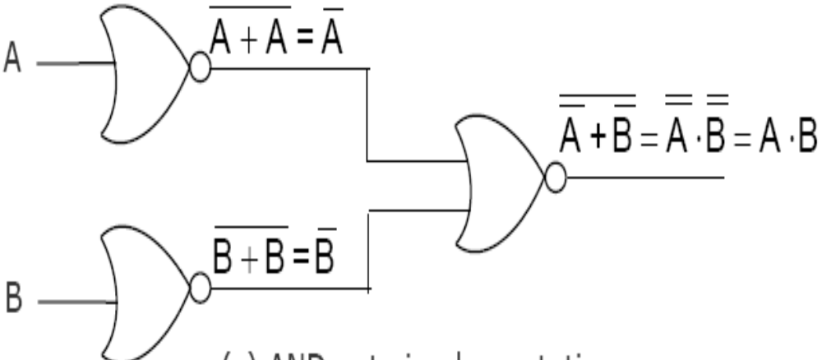
Logic Gates
Universal NOR Gate
Implementation of AND Gates by NOR Gates

Slide 27
Logic Gates
Method of Implementing a Boolean Expression
with Only NOR Gates
Step 1: For the given algebraic expression, draw the logic diagram with AND, OR, and NOT gates. Assume that both the normal and complement inputs are available
Step 2: Draw a second logic diagram with equivalent NOR logic substituted for each AND, OR, and NOT gate
Step 3: Remove all parts of cascaded inverters from the diagram as double inversion does not perform any logical function. Also remove inverters connected to single external inputs and complement the corresponding input variable

Slide 28
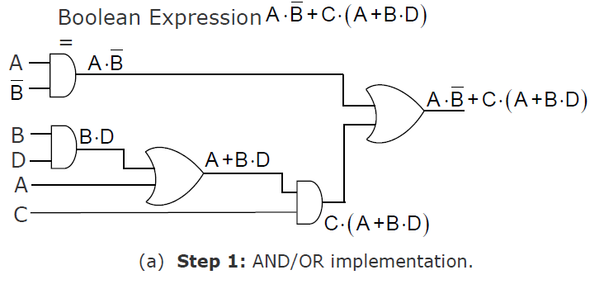
Logic Gates
Implementing a Boolean Expression with Only
NOR Gates (Examples)

Slide 29
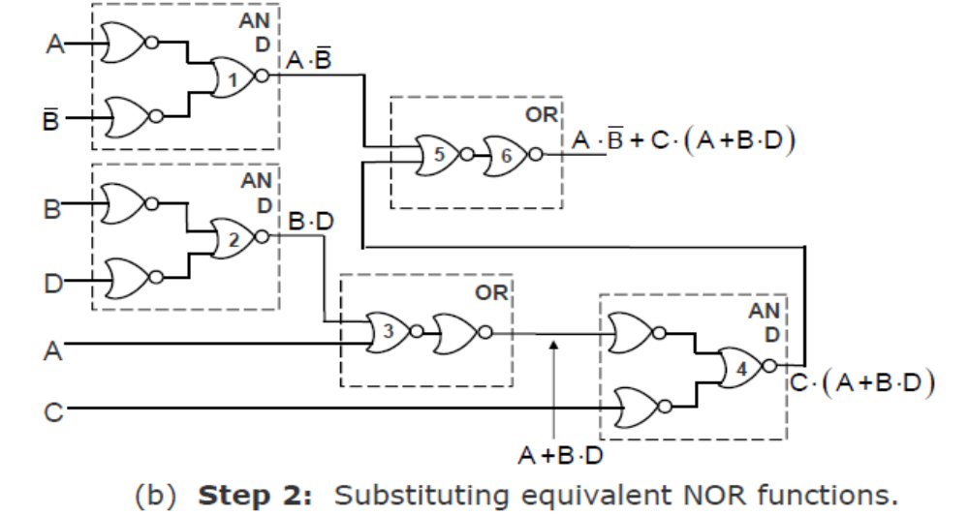
Logic Gates
Implementing a Boolean Expression with Only
NOR Gates (Examples)

Slide 30
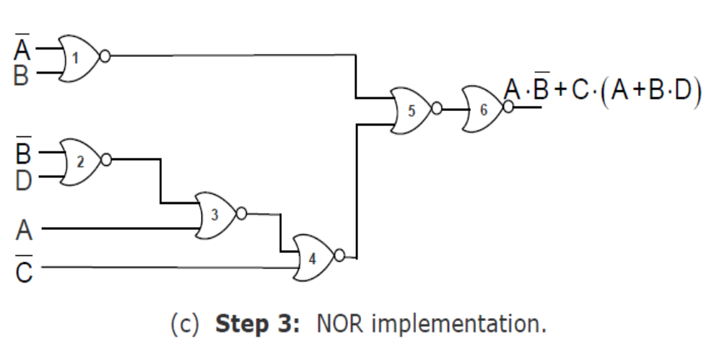
Logic Gates
Implementing a Boolean Expression with Only
NOR Gates (Examples)

Slide 31
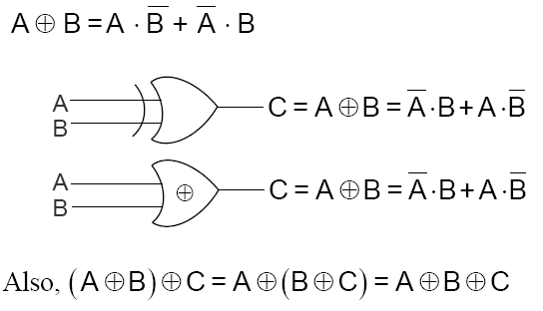
Logic Gates
Exclusive-OR Function

Slide 32
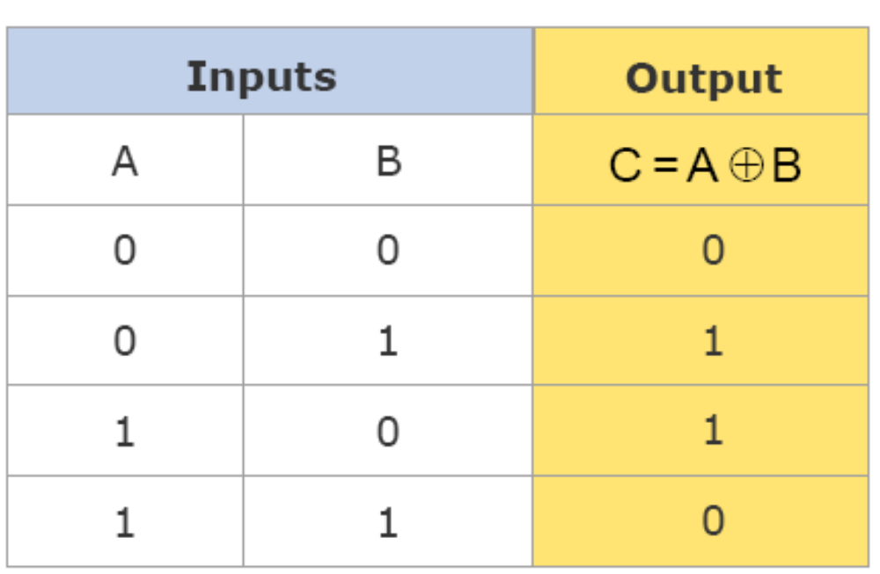
Logic Gates
Exclusive-OR Function (Truth Table)

Slide 33
Logic Gates
Exclusive-OR Function (Truth Table)

Slide 34
Number System
Positional Number Systems
Characteristics
Use only a few symbols called digits
These symbols represent different values depending on the position they occupy in the number

Slide 35
Number System
Decimal Number Systems
Characteristics
A positional number system
Has 10 symbols or digits (0, 1, 2, 3, 4, 5, 6, 7, 8, 9). Hence, its base = 10
The maximum value of a single digit is 9 (one less than the value of the base)
Each position of a digit represents a specific power of the base (10)

Slide 36
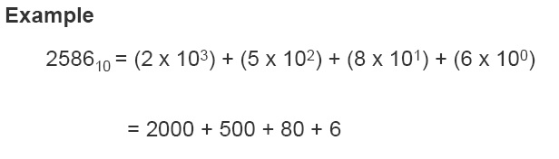
Number System
Decimal Number Systems

Slide 37
Number System
Binary Number Systems
Characteristics
A positional number system Has only 2 symbols or digits (0 and 1). Hence its base = 2
The maximum value of a single digit is 1 (one less than the value of the base)
Each position of a digit represents a specific power of the base (2)
This number system is used in computers

Slide 38
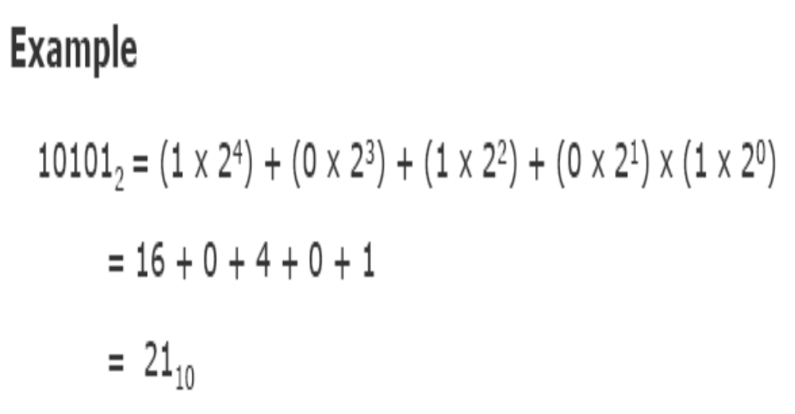
Number System
Binary Number Systems

Slide 39
Number System
Bit
Bit stands for binary digit
A bit in computer terminology means either a 0 or a 1
A binary number consisting of n bits is called an n-bit number

Slide 40
Number System
Octal Number System
Characteristics
A positional number system
Has total 8 symbols or digits (0, 1, 2, 3, 4, 5, 6, 7). Hence, its base = 8
The maximum value of a single digit is 7 (one less than the value of the base
Each position of a digit represents a specific power of the base (8)

Slide 41
Number System
Octal Number System
Characteristics
A positional number system
Has total 8 symbols or digits (0, 1, 2, 3, 4, 5, 6, 7). Hence, its base = 8
The maximum value of a single digit is 7 (one less than the value of the base
Each position of a digit represents a specific power of the base (8)

Slide 42
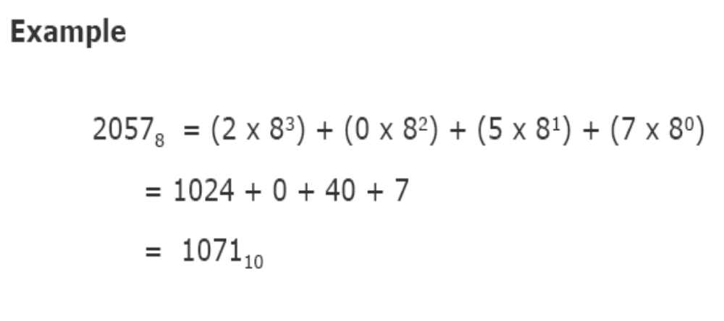
Number System
Octal Number System

Slide 43
Number System
Hexadecimal Number System
Characteristics
A positional number system
Has total 16 symbols or digits (0, 1, 2, 3, 4, 5, 6, 7, 8, 9, A, B, C, D, E, F). Hence its base = 16
The symbols A, B, C, D, E and F represent the decimal values 10, 11, 12, 13, 14 and 15 respectively
The maximum value of a single digit is 15 (one less than the value of the base)

Slide 44
Number System
Hexadecimal Number System
Each position of a digit represents a specific power of the base (16)
Since there are only 16 digits, 4 bits (24 = 16) are sufficient to represent any hexadecimal number in binary

Slide 45
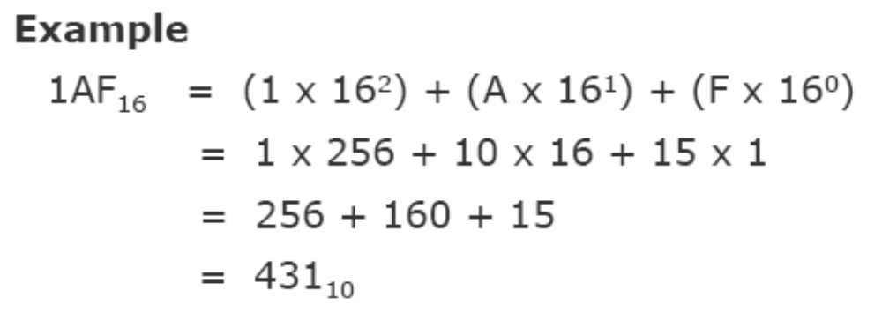
Number System
Hexadecimal Number System

Slide 46
Number System
Converting a Number of
Another Base to a Decimal Number
Method
Step 1: Determine the column (positional) value of each digit
Step 2: Multiply the obtained column values by the digits in the corresponding columns
Step 3: Calculate the sum of these products

Slide 47
Number System
Converting a Number of
Another Base to a Decimal Number
Method
Step 1: Determine the column (positional) value of each digit
Step 2: Multiply the obtained column values by the digits in the corresponding columns
Step 3: Calculate the sum of these products

Slide 48
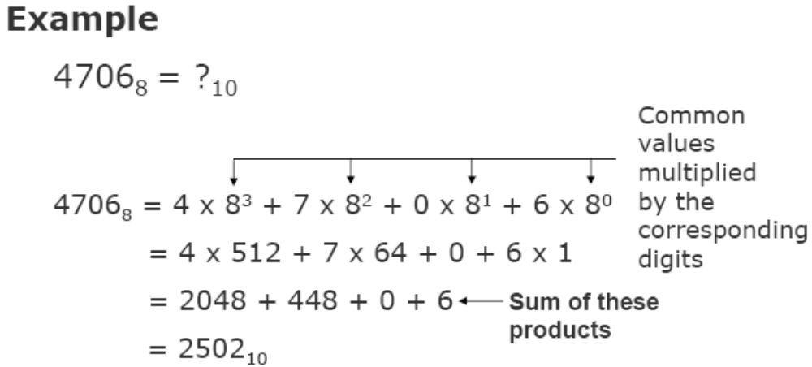
Number System
Converting a Number of
Another Base to a Decimal Number

Slide 49
Number System
Converting a
Decimal Number to a Number of Another Base
Division-Remainder Method
Step 1: Divide the decimal number to be converted by the value of the new base
Step 2: Record the remainder from Step 1 as the rightmost digit (least significant digit) of the new base number
Step 3: Divide the quotient of the previous divide by the new base
Step 4: Record the remainder from Step 3 as the next digit (to the left) of the new base number

Slide 50
Number System
Converting a
Decimal Number to a Number of Another Base
Division-Remainder Method
Repeat Steps 3 and 4, recording remainders from right to left, until the quotient becomes zero in Step 3
Note that the last remainder thus obtained will be the most significant digit (MSD) of the new base number

Slide 51
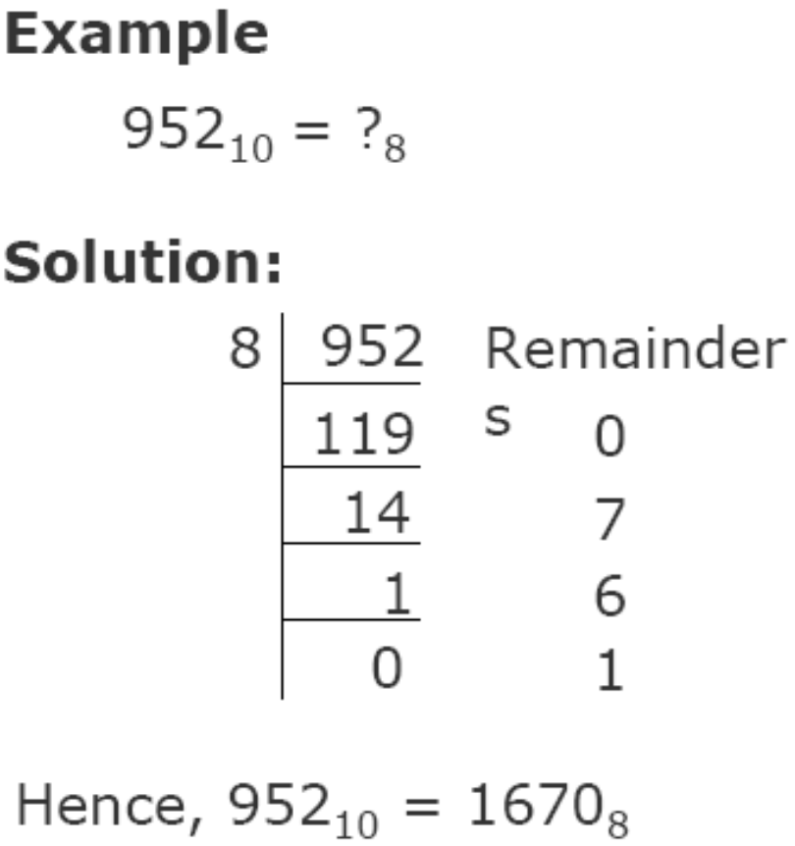
Number System
Converting a
Decimal Number to a Number of Another Base

Slide 52
Number System
Converting a Number of
Some Base to a Number of Another Base
Method
Step 1: Convert the original number to a decimal number (base 10)
Step 2: Convert the decimal number so obtained to the new base number

Slide 53
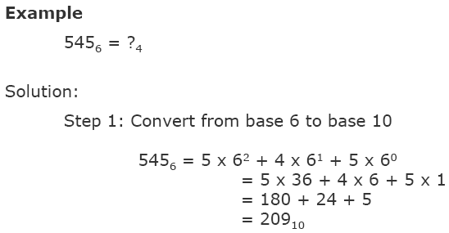
Number System
Converting a Number of
Some Base to a Number of Another Base

Slide 54
Number System
Converting a Number of
Some Base to a Number of Another Base
Step 2: Now, Convert base 10 to base 4 by dividing the result by 4.
(209)₁₀ = (3101)₄

Slide 55
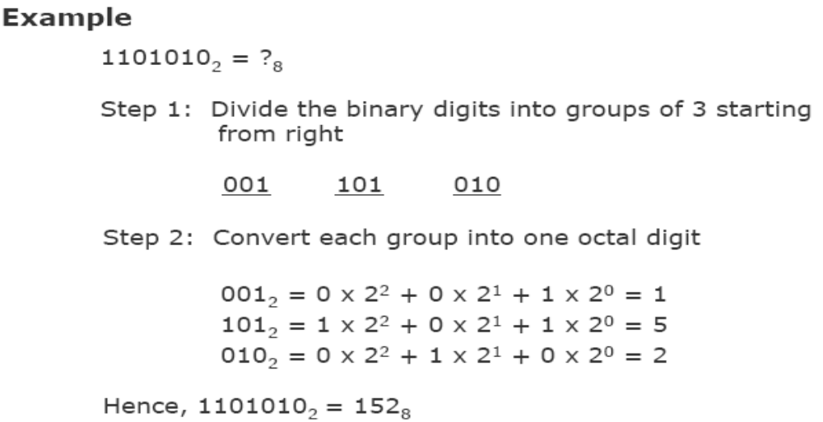
Number System
Other Method for Converting a Binary Number
to its Equivalent Octal Number

Slide 56
Number System
Other Method for Converting a Binary
Number to its Equivalent Hexadecimal Number
Method
Step 1: Divide the binary digits into groups of four starting from the right
Step 2: Combine each group of four binary digits to one hexadecimal digit

Slide 57
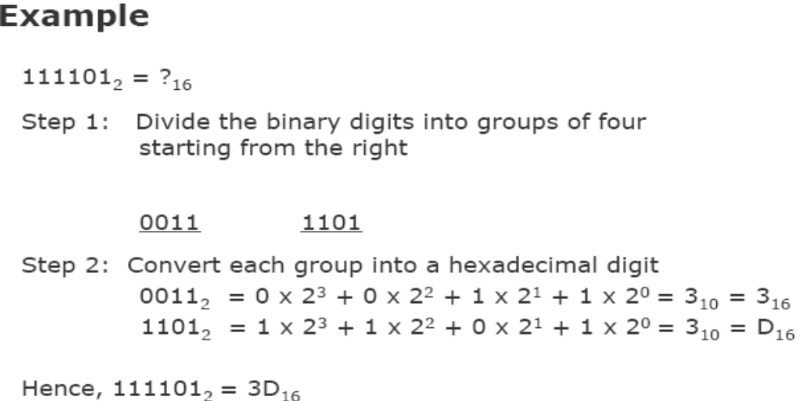
Number System
Other Method for Converting a Binary
Number to its Equivalent Hexadecimal Number

Slide 58
Number System
Other Method for Converting a Hexadecimal
Number to its Equivalent Binary Number
Method
Step 1: Convert the decimal equivalent of each hexadecimal digit to a 4 digit binary number
Step 2: Combine all the resulting binary groups (of 4 digits each) in a single binary number

Slide 59
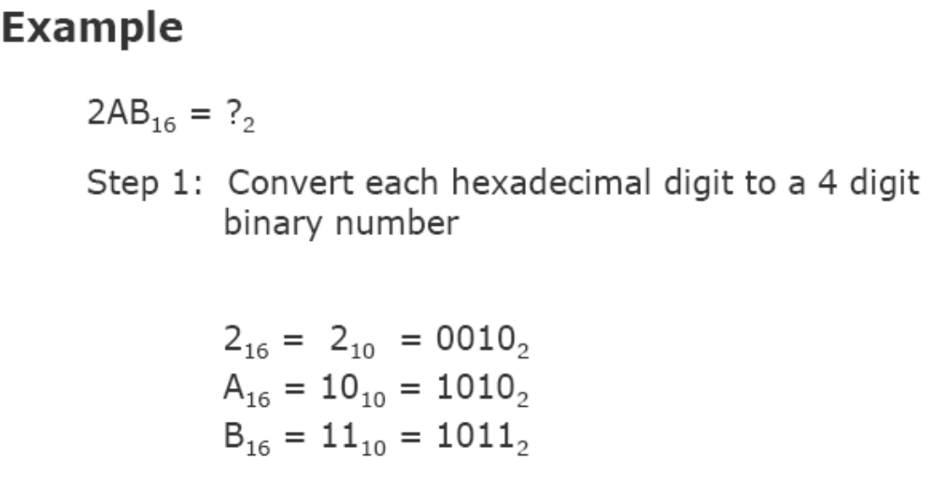
Number System
Other Method for Converting a Hexadecimal
Number to its Equivalent Binary Number

Slide 60
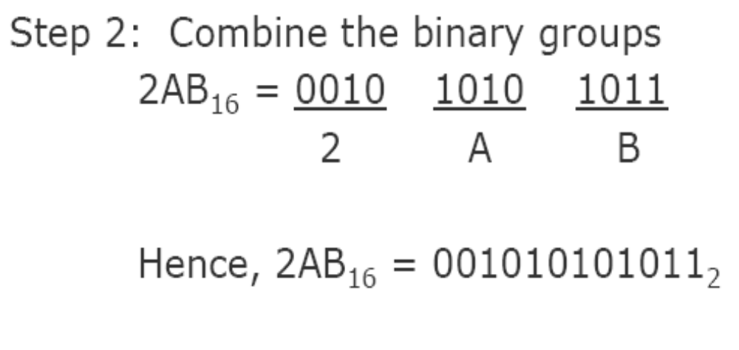
Number System
Other Method for Converting a Hexadecimal
Number to its Equivalent Binary Number

Slide 61
Number System
Fractional Numbers
Fractional numbers are formed same way as decimal number system

Slide 62
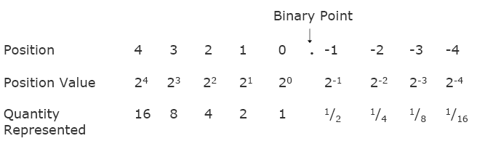
Number System
Fractional Numbers in Binary Number System

Slide 63
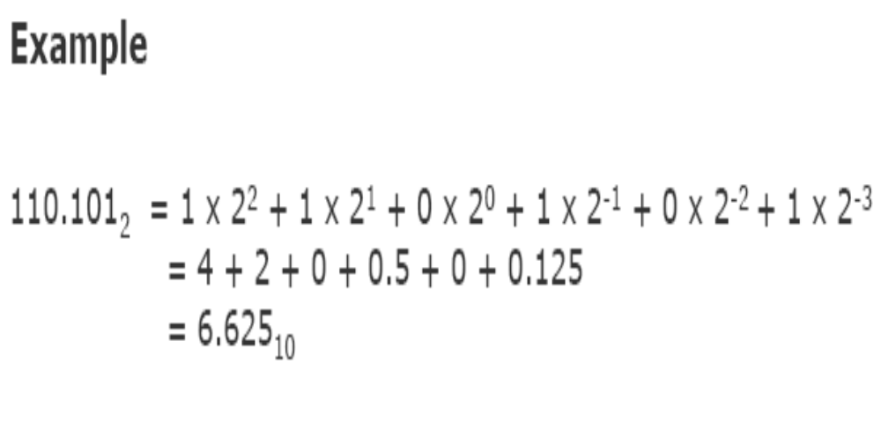
Number System
Fractional Numbers in Binary Number System

Slide 64
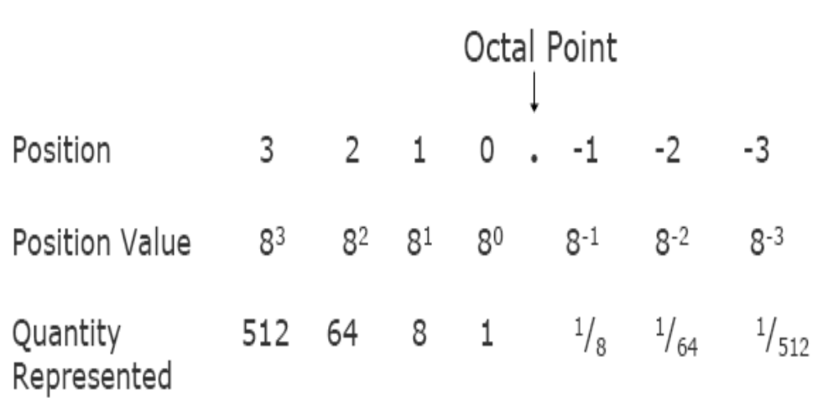
Number System
Fractional Numbers in Octal Number System

Slide 65
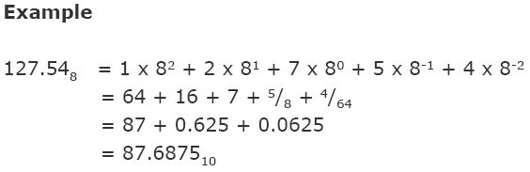
Number System
Fractional Numbers in Octal Number System

Slide 66
Binary Arithmetic
Information is handled in a computer by electronic/ electrical components
Electronic components operate in binary mode (can only indicate two states – on (1) or off (0)
Binary number system has only two digits (0 and 1), and is suitable for expressing two possible states
In binary system, computer circuits only have to handle two binary digits rather than ten decimal digits causing:
  Simpler internal circuit design
  More reliable circuits
Arithmetic rules/processes possible with binary numbers

Slide 67
Binary Arithmetic
Binary arithmetic is simple to learn as binary number system has only two digits – 0 and 1

Slide 68
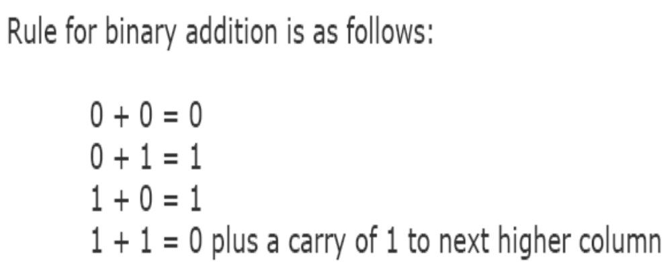
Binary Arithmetic
Binary Addition

Slide 69
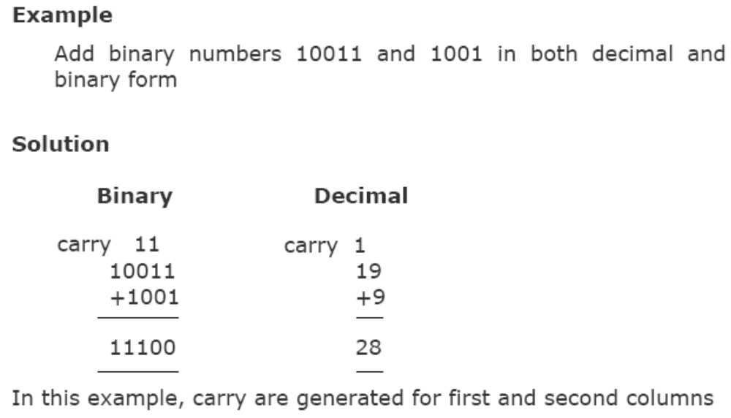
Binary Arithmetic
Binary Addition

Slide 70
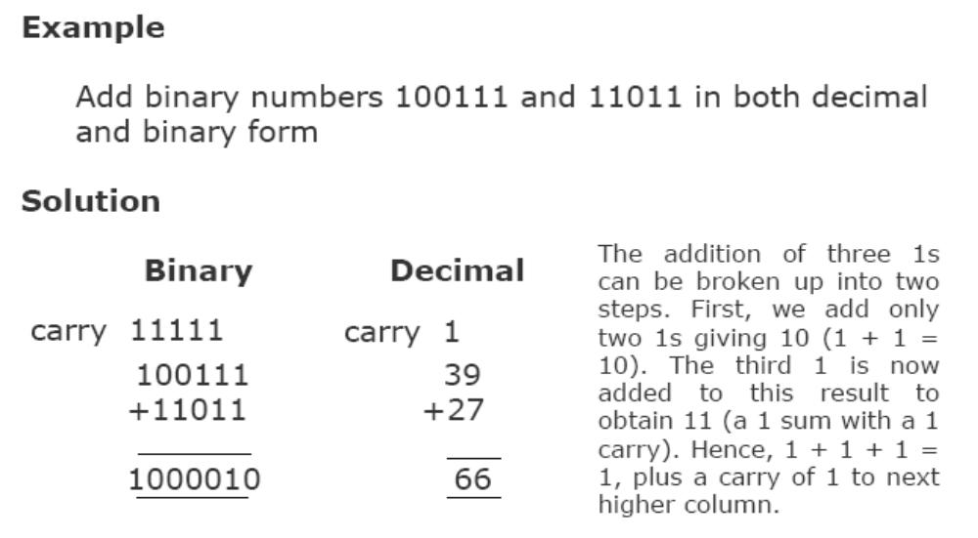
Binary Arithmetic
Binary Addition

Slide 71
Binary Arithmetic
Binary Subtraction
Rule for binary subtraction is as follows:
0 - 0 = 0
0 - 1 = 1 with a borrow from the next column
1 - 0 = 1
1 - 1 = 0

Slide 72
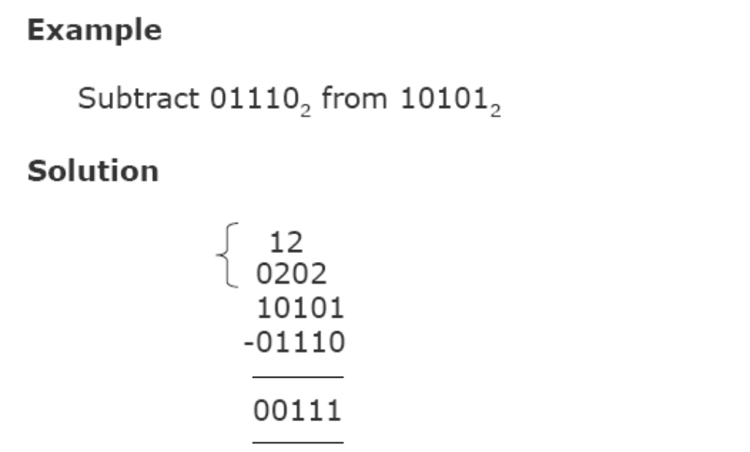
Binary Arithmetic
Binary Subtraction

Slide 73
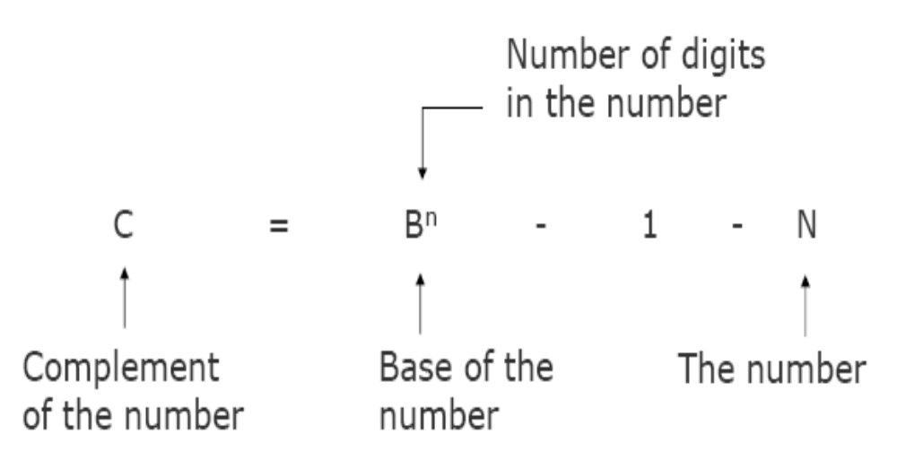
Binary Arithmetic
(r-1)’s Complement of a Number

Slide 74
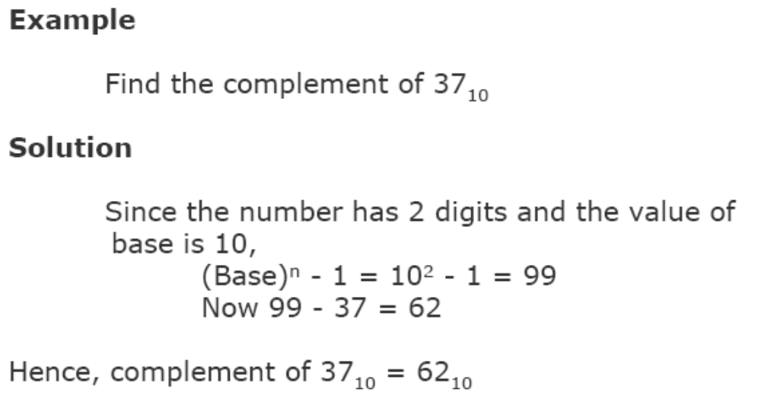
Binary Arithmetic
(r-1)’s Complement of a Number

Slide 75
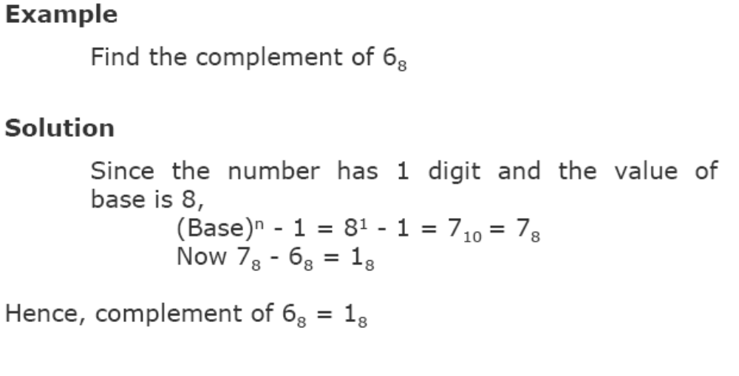
Binary Arithmetic
(r-1)’s Complement of a Number

Slide 76
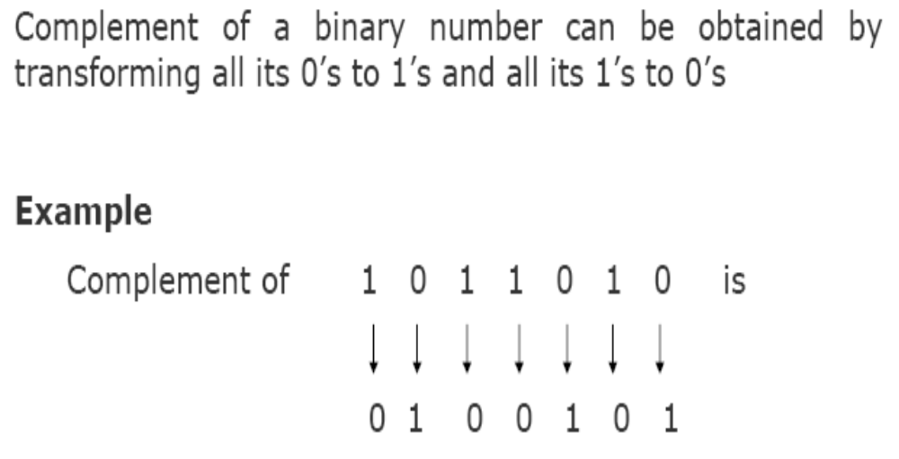
Binary Arithmetic
Complement of a Binary Number

Slide 77
Binary Arithmetic
(r-1)’s Complementary Subtraction
Involves following 3 steps:
Step 1: Find the complement of the number you are subtracting (subtrahend)
Step 2: Add this to the number from which you are taking away (minuend)
Step 3: If there is a carry of 1, add it to obtain the result; if there is no carry, recomplement the sum and attach a negative sign

Slide 78
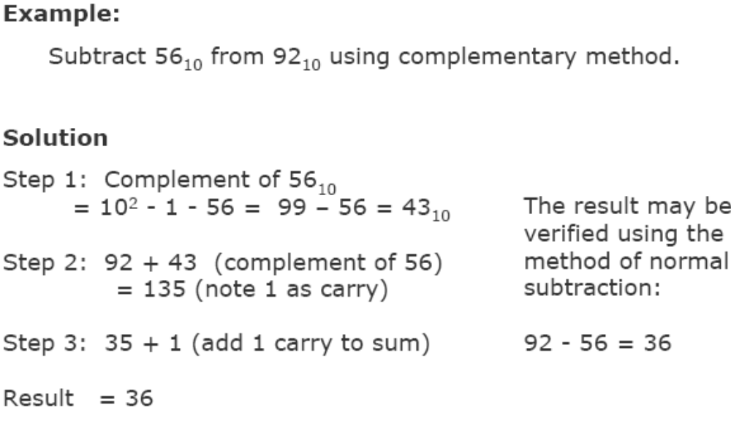
Binary Arithmetic
(r-1)’s Complementary Subtraction

Slide 79
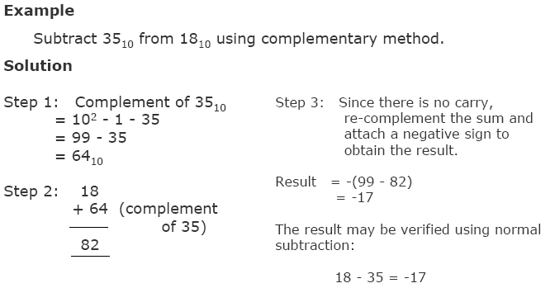
Binary Arithmetic
(r-1)’s Complementary Subtraction

Slide 80
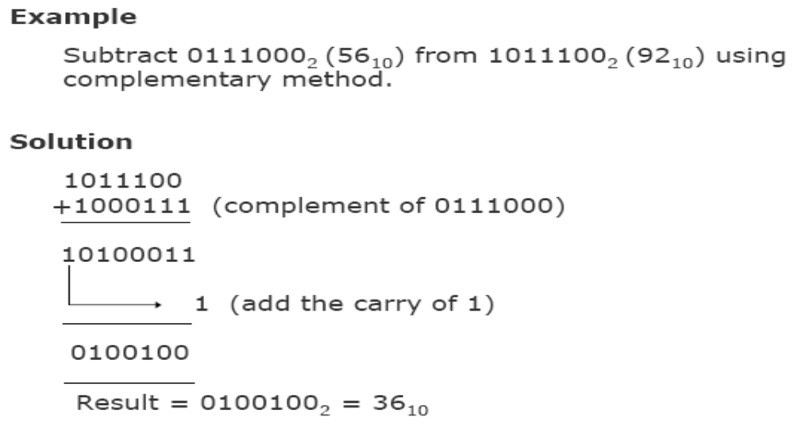
Binary Arithmetic
Binary Subtraction using Complementary Method

Slide 81
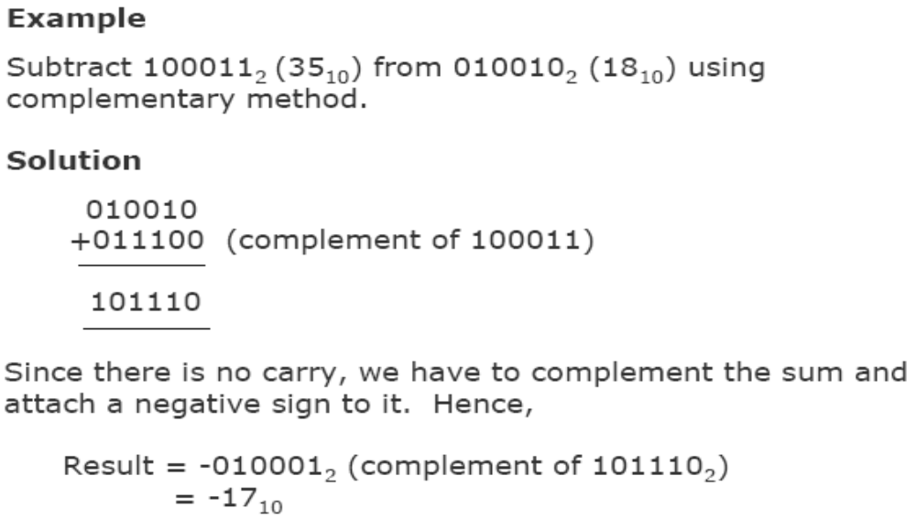
Binary Arithmetic
Binary Subtraction using Complementary Method

Slide 82

Binary Arithmetic
Binary Multiplication

Slide 83

Binary Arithmetic
Binary Multiplication

Slide 84

Binary Arithmetic
Binary Multiplication

Slide 85

Binary Arithmetic
Binary Division

Slide 86
Binary Arithmetic
Rules for Binary Division
1. Start from the left of the dividend
2. Perform a series of subtractions in which the divisor is subtracted from the dividend
3. If subtraction is possible, put a 1 in the quotient and
subtract the divisor from the corresponding digits of
dividend
4. If subtraction is not possible (divisor greater than remainder), record a 0 in the quotient
5. Bring down the next digit to add to the remainder
digits. Proceed as before in a manner similar to long
division

Slide 87

Binary Arithmetic
Binary Division

Slide 88

Microprocessor
Architecture of 8085

Slide 89
Microprocessor
Components
  Control Unit (CU)
  ALU
  Registers (PC, DR, AR, IR, MAR, MBR, Stack Pointer, Flags)
    Register selector
  Bus (System bus, Address bus, Data bus, Control bus)
Addressing Modes
Instruction formats
Types of Micro operations

Slide 90
Microprocessor
Control Unit
Generates signals within up to carry out the instruction, which has been decoded.
The control unit provides the timing and control signal to all operations of microcomputer. It control the flow of data between microprocessor and memory and peripherals.
It reads and interprets instructions and determines the sequence for processing the data.
It is responsible to direct the system to execute instructions.
It helps in communication between the memory and the arithmetic logical unit.

Slide 91
Microprocessor
Components
Arithmetic Logic Unit
The ALU performs the actual numerical and logic operation such as ‘add’, ‘subtract’, ‘AND’, ‘OR’, etc.
Uses data from memory and from Accumulator to perform arithmetic.
Always stores result of operation in Accumulator register.

Slide 92
Microprocessor
Registers
Registers can be considered to be special purpose memory which reside within the CPU.
The registers are high speed temporary memory used to help the CPU get access to data and instructions quickly and effectively.
This memory is vital for moving data in and out of the main memory and to process the data. When CPU executes the instructions, there is a transfer of information between various units of the computer system. CPU uses these registers to handle the process of execution efficiently.
They can hold only one piece of data at a time. Registers receive the information, hold it temporarily and pass it on as directed by the control unit. The number of registers varies from computer to computer, each one designed to perform a specific function.

Slide 93
Microprocessor
Registers
Types of registers are:
    AC Accumulator Register 16 bits
    MAR Memory Address Register 12 – 16 bits
    DR Data Register 16 bits
    IR Instruction Register 16 bits
    PC Program Counter 12 – 16 bits
    TR Temporary Register 16 bits
    INPR Input Register 8 bits
    PUTR Output Register 8 bits

Slide 94
Microprocessor
Registers
Registers Perform:-
1) Fetch: The Fetch Operation is used for taking the instructions those are given by the user and the Instructions those are stored into the Main Memory will be fetch by using Registers.
2) Decode: The Decode Operation is used for interpreting the Instructions means the Instructions are decoded means the CPU will find out which Operation is to be performed on the Instructions.
3) Execute: The Execute Operation is performed by the CPU. And Results those are produced by the CPU are then Stored into the Memory and after that they are displayed on the user Screen.

Slide 95
Microprocessor
Registers
Accumulator
The accumulator is a 16-bit register that is a part of arithmetic/logic unit (ALU).
This register is used to store data and to perform arithmetic and logical operations.
The CPU stores the result after processing in the accumulator.
The accumulator is also identified as register A.

Slide 96
Microprocessor
Registers
DR (Memory Data Register)
MDR is the register of a computer's control unit that contains the data to be stored in the computer storage (e.g. RAM), or the data after a fetch from the computer storage.
It acts like a buffer and holds anything that is copied from the memory ready for the processor to use it.
MDR which contains the data to be written into or readout of the addressed location

Slide 97
Microprocessor
Program Counter (PC)
This 16-bit register deals with sequencing the execution of instructions.
This register is a memory pointer. Memory locations have 16-bit addresses, and that is why this is a 16-bit register.
The microprocessor uses this register to sequence the execution of the instructions.
The function of the program counter is to point to the memory address from which the next byte is to be fetched. When a byte (machine code) is being fetched, the program counter is incremented by one to point to the next memory location

Slide 98
Microprocessor
Instruction Register/Decoder
Temporary store for the current instruction of a program. Latest instruction sent here from memory prior to execution.
Decoder then takes instruction and ‘decodes’ or interprets the instruction. Decoded instruction then passed to next stage.
Memory Address Register
Holds address, received from PC, of next program instruction.
This register holds the memory addresses of data and instructions
Feeds the address bus with addresses of location of the program under execution.

Slide 99
Microprocessor
Components
Stack Pointer (SP)
The stack pointer is also a 16-bit register used as a memory pointer.
It points to a memory location in R/W memory, called the stack.
The beginning of the stack is defined by loading 16-bit address in the stack pointer.

Slide 100
GENERAL REGISTER ORGANIZATION
General Register Organization
Clock
Input
R1
R2
R3
R4
R5
R6
R7
Load
(7 lines)
{
MUX
MUX
}
SELB
SELA
3 x 8
A bus
B bus
decoder
SELD
ALU
OPR
Output

Slide 101
OPERATION OF CONTROL UNIT
Control
The control unit
Directs the information flow through ALU by
- Selecting various Components in the system
- Selecting the Function of ALU
Example: R1 ← R2 + R3
[1] MUX A selector (SELA): BUS A ← R2
[2] MUX B selector (SELB): BUS B ← R3
[3] ALU operation selector (OPR): ALU to ADD
[4] Decoder destination selector (SELD): R1 ← Out Bus
3
3
3
5
Control Word
SELA
SELB
SELD
OPR
Encoding of register selection fields
  Binary
  Code SELA SELB SELD
  000 Input Input None
  001 R1 R1 R1
  010 R2 R2 R2
  011 R3 R3 R3
  100 R4 R4 R4
  101 R5 R5 R5
  110 R6 R6 R6
  R7 R7 R7

Slide 102
Microprocessor
Control Generator
Generates signals within uP to carry out the instruction which has been decoded.
In reality causes certain connections between blocks of the uP to be opened or closed, so that data goes where it is required, and so that ALU operations occur.
Register Selector
This block controls the use of the register stack in the example. Just a logic circuit which switches between different registers in the set will receive instructions from Control Unit.

Slide 103
Microprocessor
Register A
Register B
Register C
Register D
1
2
3
4
1
2
3
4
1
2
3
4
1
2
3
4
B
1
C
1
D
1
B
C
D
B
C
D
B
C
D
2
2
2
3
3
3
4
4
4
0
4 x1
0
4 x1
0
4 x1
0
4 x1
MUX
MUX
MUX
MUX
x
select
y
4-line bus
Bus System for 4-bit register

Slide 104
Microprocessor
8085 System Bus
A bus is a set of parallel wires with rules for putting and retrieving information on the wires.
A digital communication mechanism that allows two or more functional units to transfer control signals or data.
The connection medium allowing the CPU, memory and I/O controllers to communicate .
A typical microprocessor communicates with memory and other devices (input and output) using three busses: Address Bus, Data Bus and Control Bus.

Slide 105
Microprocessor
Address Bus
These buses carry address given by the CPU from one unit to another in the computer.
The address bus consists of all the signals necessary to define any of the possible memory address locations within the computer. One wire for each bit, therefore 16 bits = 16 wires.
A 16 bit binary number allows 2¹⁶ different numbers, or 32000 different numbers, ie 0000000000000000 up to 1111111111111111.
Before data or instructions can be written into or read from memory by the CPU or I/O sections, an address must be transmitted to memory over the address bus.

Slide 106
Microprocessor
Data Bus
Data Bus: carries ‘data’, in binary form, between μP and other external units, such as memory.
The bidirectional data bus, sometimes called the memory bus, handles the transfer of all data and instructions between functional areas of the computer.
The bidirectional data bus can only transmit in one direction at a time.
The data bus is used to transfer instructions from memory to the CPU for execution. It carries data (operands) to and from the CPU and memory as required by instruction translation.
The data bus is also used to transfer data between memory and the I/O section during input/output operations.

Slide 107
Microprocessor
Control Bus
Control Bus are various lines which have specific functions for coordinating and controlling uP operations.
These buses carry control signal from ALU to memory and from memory to ALU and then to the output unit.
The control bus is used by the CPU to direct and monitor the actions of the other functional areas of the computer. It is used to transmit a variety of individual signals (read, write, interrupt, acknowledge, and so forth) necessary to control and coordinate the operations of the computer.
Eg: Read/Write line, single binary digit. Control whether memory is being ‘written to’ (data stored in mem) or ‘read from’ (data taken out of mem) 1 = Read, 0 = Write.
Typically μP has 10 control lines. μP cannot function correctly without these vital control signals.

Slide 108
Microprocessor
Instruction Format
An instruction is a command to the microprocessor to perform a given task on a specified data.
A computer instruction is often divided into two parts
  An opcode (Operation Code) that specifies the operation for that instruction
  An address that specifies the registers and/or locations in memory to use for that operation
The operand (or data) can be specified in various ways. It may include 8-bit (or 16-bit ) data, an internal register, a memory location, or 8-bit (or 16-bit) address.
In some instructions, the operand is implicit.
For eg: Complement
This will complement Accumulator.
Instruction Format
15
14
12
11
0
I
Opcode
Address
Addressing
mode

Slide 109
Microprocessor
The address field of an instruction can represent either
  Direct address: the address in memory of the data to use (the address of the operand), or
  Indirect address: the address in memory of the address in memory of the data to use
Effective Address (EA)
  The address, that can be directly used without modification to access an operand for a computation-type instruction, or as the target address for a branch-type instruction
Direct addressing
Indirect addressing
22
0
ADD
457
35
1
ADD
300
300
1350
457
Operand
1350
Operand
+
+
AC
AC

Slide 110
Microprocessor
Instruction Format
Instruction word size
The 8085 instruction set is classified into the following three groups according to word size:
1. One-word or 1-byte instructions
2. Two-word or 2-byte instructions
3. Three-word or 3-byte instructions
In the 8085, "byte" and "word" are synonymous because it is an 8-bit microprocessor. However, instructions are commonly referred to in terms of bytes rather than words.

Slide 111
THREE, AND TWO-ADDRESS INSTRUCTIONS
Instruction Format
Three-Address Instructions
Program to evaluate X = (A + B) * (C + D) :
ADD R1, A, B /* R1 ← M[A] + M[B] */
ADD R2, C, D /* R2 ← M[C] + M[D] */
MUL X, R1, R2 /* M[X] ← R1 * R2 */
- Results in short programs
- Instruction becomes long (many bits)
Two-Address Instructions
Program to evaluate X = (A + B) * (C + D) :
MOV R1, A /* R1 ← M[A] */
ADD R1, B /* R1 ← R1 + M[A] */
MOV R2, C /* R2 ← M[C] */
ADD R2, D /* R2 ← R2 + M[D] */
MUL R1, R2 /* R1 ← R1 * R2 */
MOV X, R1 /* M[X] ← R1 */

Slide 112
ONE, AND ZERO-ADDRESS INSTRUCTIONS
Instruction Format
One-Address Instructions
- Use an implied AC register for all data manipulation
- Program to evaluate X = (A + B) * (C + D) :
LOAD A /* AC ← M[A] */
ADD B /* AC ← AC + M[B] */
STORE T /* M[T] ← AC */
LOAD C /* AC ← M[C] */
ADD D /* AC ← AC + M[D] */
MUL T /* AC ← AC * M[T] */
STORE X /* M[X] ← AC */
Zero-Address Instructions
- Can be found in a stack-organized computer
- Program to evaluate X = (A + B) * (C + D) :
PUSH A /* TOS ← A */
PUSH B /* TOS ← B */
ADD /* TOS ← (A + B) */
PUSH C /* TOS ← C */
PUSH D /* TOS ← D */
ADD /* TOS ← (C + D) */
MUL /* TOS ← (C + D) * (A + B) */
POP X /* M[X] ← TOS */

Slide 113
Microprocessor
The 8085 Addressing Modes
The various formats for specifying operands are called the ADDRESSING MODES. For 8085, they are:
1. Immediate addressing.
2. Register addressing.
3. Direct addressing.
4. Indirect addressing.

Slide 114
Microprocessor
The 8085 Addressing Modes
Immediate addressing
Data is present in the instruction itself. Load the immediate data to the destination provided.
Example: MVI R, data [means R ← data]
The instruction will have an operand field rather than an address field.
This is useful for initializing register with a constant value.
Register addressing
In this mode, the operands are in registers that reside within the CPU.
Example: MOV Rd, Rs [means Rd ← Rs]

Slide 115
Microprocessor
The 8085 Addressing Modes
Direct addressing
Used to accept data from memory, to store it in the accumulator or send the data stored in the accumulator to the memory.
The operand resides in memory and its address is given by the address field of the instruction.
Example: Load X (means AC ← m[X])
    or
    Store X (means M[X] ← AC)

Slide 116
Microprocessor
The 8085 Addressing Modes
Indirect Addressing
This means that the Effective Address is calculated by the processor.
And the contents of the address is used to form a second address.
The second address is where the data is actually stored.
Note that this requires several memory accesses; two accesses to retrieve the 16-bit address and a further access (or accesses) to retrieve the data which is to be loaded into the register.

Slide 117
Microprocessor
Instruction Set Classification
An instruction is a binary pattern designed inside a microprocessor to perform a specific function. They are also called Microinstructions.
The entire group of instructions, called the instruction set, determines what functions the microprocessor can perform.
The micro operations performed by these instructions can be classified into the following five functional categories: data transfer (copy) operations, arithmetic operations, logical operations, branching operations, and machine-control operations.

Slide 118
Microprocessor
Data Transfer (Copy) Operations
This group of instructions copy data from a location called a source to another location called a destination, without modifying the contents of the source.
In technical manuals, the term data transfer is used for this copying function.
However, the term transfer is misleading; it creates the impression that the contents of the source are destroyed when, in fact, the contents are retained without any modification.
The various types of data transfer (copy) are listed below together with examples of each type:

Slide 119

Microprocessor
Data Transfer (Copy) Operations

Slide 120
Microprocessor
Table 4.2.
Arithmetic Operations
These instructions perform arithmetic operations such as addition, subtraction, increment, and decrement.
Example | Description
R3 ← R1 + R2 | Addition
R3 ← R1 - R2 (R1 + R2' + 1) | Subtraction
R2 ← R2' | Complement (really a logic operation)
R2 ← -R2 (R2' + 1) | Negation
R1 ← R1 + 1 | Increment
R1 ← R1 - 1 | Decrement

Slide 121
Microprocessor
Arithmetic Micro Operations
Addition
Any 8-bit number, or the contents of a register or the contents of a memory location can be added to the contents of the accumulator and the sum is stored in the accumulator.
No two other 8-bit registers can be added directly (e.g., the contents of register B cannot be added directly to the contents of the register C).
The instruction DAD is an exception; it adds 16-bit data directly in register pairs.

Slide 122
Microprocessor
Arithmetic Operations
Subtraction
Any 8-bit number, or the contents of a register, or the contents of a memory location can be subtracted from the contents of the accumulator and the results stored in the accumulator.
The subtraction is performed in 2's compliment, and the results if negative, are expressed in 2's complement.
No two other registers can be subtracted directly.

Slide 123
Microprocessor
Arithmetic Operations
Increment/Decrement
The 8-bit contents of a register or a memory location can be incremented or decrement by 1.
Similarly, the 16-bit contents of a register pair (such as BC) can be incremented or decrement by 1.
These increment and decrement operations differ from addition and subtraction in an important way; i.e., they can be performed in any one of the registers or in a memory location.

Slide 124



BINARY ADDER / SUBTRACTOR / INCREMENTER
Arithmetic Microoperations
Binary Adder
Binary Adder-Subtractor
Binary Incrementer

Slide 125


Slide 126
S1 S0 Cin Y Output Microoperation
0 0 0 B D = A + B Add
0 0 1 B D = A + B + 1 Add with carry
0 1 0 B’ D = A + B’ Subtract with borrow
0 1 1 B’ D = A + B’+ 1 Subtract
1 0 0 0 D = A Transfer A
1 0 1 0 D = A + 1 Increment A
1 1 0 1 D = A - 1 Decrement A
1 1 1 1 D = A Transfer A

Slide 127

Microprocessor
Logical Operations
These instructions perform various logical operations with the contents of the accumulator.

Slide 128
HARDWARE IMPLEMENTATION OF LOGIC MICROOPERATIONS
Logic Microoperations
A
i
0
B
i
1
4 X 1
F
MUX
i
2
3
Select
S
1
S
0
Function table
S₁ S₀
Output
μ-operation
0 0 F = A ∧ B AND
0 1 F = A ∨ B OR
1 0 F = A ⊕ B XOR
1 1 F = A’ Complement

Slide 129
Microprocessor
Shift Micro Operations
    Shift microoperations are used for serial transfer of data
    Three types of shift microoperation : Logical, Circular, and ArithmeticShift microoperations are used for serial transfer of data.
Symbolic designation Description
R ← shl R Shift-left register R
R ← shr R Shift-right register R
R ← cil R Circular shift-left register R
R ← cir R Circular shift-right register R
R ← ashl R Arithmetic shift-left R
R ← ashr R Arithmetic shift-right R

Slide 130
SHIFT MICROOPERATIONS
Shift Microoperations
There are three types of shifts
  Logical shift
  Circular shift
  Arithmetic shift
What differentiates them is the information that goes into the serial input
A right shift operation
A left shift operation
Serial
input
Serial
input

Slide 131
LOGICAL SHIFT
Shift Microoperations
In a logical shift the serial input to the shift is a 0.
A right logical shift operation:
A left logical shift operation:
In a Register Transfer Language, the following notation is used
  shl for a logical shift left
  shr for a logical shift right
  Examples:
    R2 ← shr R2
    R3 ← shl R3
0
0

Slide 132
CIRCULAR SHIFT
Shift Microoperations
In a circular shift the serial input is the bit that is shifted out of the other end of the register.
A right circular shift operation:
A left circular shift operation:
In a RTL, the following notation is used
  cil for a circular shift left
  cir for a circular shift right
  Examples:
    R2 ← cir R2
    R3 ← cil R3

Slide 133
ARITHMETIC SHIFT
An arithmetic shift is meant for signed binary numbers (integer)
An arithmetic left shift multiplies a signed number by two
An arithmetic right shift divides a signed number by two
The main distinction of an arithmetic shift is that it must keep the sign of the number the same as it performs the multiplication or division
A right arithmetic shift operation:
A left arithmetic shift operation:
sign
bit
0
sign
bit

Slide 134
HARDWARE IMPLEMENTATION OF SHIFT MICROOPERATIONS
Serial
input (I_{R})
Select
0 for shift right (down)
1 for shift left (up)
Functional Table
S
H0
0
MUX
Select | Output
S | H₀ | H₁ | H₂ | H₃
0 | I_{R} | A₀ | A₁ | A₂
1 | A₁ | A₂ | A₃ | I_{L}
1
A0
A1
S
H1
0
MUX
A2
1
A3
S
0
MUX
H2
1
S
H3
0
MUX
1
Serial
input (I_{L})
4-BIT COMBINATIONAL SHIFTER

Slide 135

One stage of Arithmetic Logic shift unit

Slide 136
ARITHMETIC LOGIC SHIFT UNIT
  S3 S2 S1 S0 Cin Operation Function
  0 0 0 0 0 F = A Transfer A
  0 0 0 0 1 F = A + 1 Increment A
  0 0 0 1 0 F = A + B Addition
  0 0 0 1 1 F = A + B + 1 Add with carry
  0 0 1 0 0 F = A + B’ Subtract with borrow
  0 0 1 0 1 F = A + B’+ 1 Subtraction
  0 0 1 1 0 F = A - 1 Decrement A
  0 0 1 1 1 F = A Transfer A
  0 1 0 0 X F = A ∧ B AND
  0 1 0 1 X F = A ∨ B OR
  0 1 1 0 X F = A ⊕ B XOR
  0 1 1 1 X F = A’ Complement A
  1 0 X X X F = shr A Shift right A into F
  1 1 X X X F = shl A Shift left A into F

Slide 137
Microprocessor
Branching Operations
This group of instructions alters the sequence of program execution either conditionally or unconditionally.
A branch instruction calls for a transfer to a non consecutive instruction in the program. The address part of the branch instruction is transferred to PC to become the address of the next instruction.

Slide 138
Microprocessor
Branching Operations
Jump
Conditional jumps are an important aspect of the decision-making process in the programming.
These instructions test for a certain conditions (e.g., Zero or Carry flag) and alter the program sequence when the condition is met. In addition, the instruction set includes an instruction called unconditional jump.

Slide 139
Microprocessor
Branching Operations
Call, Return, and Restart
These instructions change the sequence of a program either by calling a subroutine or returning from a subroutine.
The conditional Call and Return instructions also can test condition flags.

Slide 140
Microprocessor
Some important aspects of the instruction set are noted below:
1. In data transfer, the contents of the source are not destroyed; only the contents of the destination are changed. The data copy instructions do not affect the flags.
2. Arithmetic and Logical operations are performed with the contents of the accumulator, and the results are stored in the accumulator (with some expectations). The flags are affected according to the results.
3. Any register including the memory can be used for increment and decrement.
4. A program sequence can be changed either conditionally or by testing for a given data condition.

Slide 141
Conclusion
  Digital Signals and Logic gates
    AND
    OR
    NOT
    NAND
    NOR
    Boolean Expression
  Number systems
    Binary
    octal and hexadecimal number systems
    binary arithmetic
    2’s complement arithmetic
  Microprocessors:
    Introduction
    System Bus
    Architecture of 8085 microprocessor
    Instruction Set
    Arithmetic Operations
    Logical Operations
    Branching Operations
    Instruction Format

Slide 142
Objective Type
In Microprocessor, word or byte are same. (T/F)
2. OR gate generates an output signal of 1 only if all input signals are also 1. (T/F)
3. What is combinational circuit?
4. A binary number consisting of n bits is called an n-bit number. (T/F)
5. Data is present in the instruction. Load the immediate data to the destination provided :
a) Immediate addressing.
b) Register addressing.
c) Direct addressing.
d) Indirect addressing.

Slide 143
Objective Type
6. This group of instructions alters the sequence of program execution either conditionally or unconditionally
a) Arithmetic
b) Logical
c) Branching
7. What is 2-Byte Instruction.
8. What it means - MOV rd, rs ?
9. In register addressing, data is provided through the registers ?
10. What is immediate addressing?

Slide 144
Short Questions
What are the Logic Gates?
Explain the principle of duality in Boolean algebra. How it is useful?
Find the complement of 011011.
Multiply binary numbers 1100 and 1010.
What is the primary advantage of performing subtraction by complementary method in digital computers?
What is branching operation in Microprocessor?
Explain arithmetic operation in Microprocessor?
Explain direct addressing?
Prepare truth table for A.B+A’.B
Find the Complement of A.(B’+C’).

Slide 145
Short Questions
11. Find the complement of 495_{10.}
12. Subtract 01010₂ from 1000₂.
13. Find decimal equivalent of 1101011.
14. Convert the 435₁₀ to binary numbers.
15. Convert the 110110₂ number to decimal numbers.

Slide 146
Long Questions
What are the different types of number system.
Discuss the various operations on Binary numbers.
Explain how multiplication and division operations are performed in a computer by using additive approach.
What the components of Microprocessor 8085?
Explain 2’s complement of binary number.
Explain the architecture of Microprocessor 8085 ?
What are the different addressing modes in Microprocessor 8085?
What are the different instruction formats in Microprocessor 8085?
Explain three types of operations on Microprocessor ?
Explain data transfer operations in Microprocessor 8085.

Slide 147
References
Main Reading Books:
1. P. K. Sinha and Priti Sinha , “Computer Fundamentals”, BPB Publications, 2007.
2. Alex Leon and Mathews Leon, “Fundamentals of Information Technology”, Leon Techworld, 2007.
3. V. Rajaraman, “Introduction to Information Technology”, PHI, 2006.
REFERENCES:
1. Alex Leon and Mathews Leon, “Introduction to Computers”, Vikas Publishing House,2007.
2. Norton Peter, “Introduction to computers”, TMH, 4th Ed., 2006.
3. Simon Haykins, “Communication System”, John Wiley & Sons, 2006.
4. B. Basaraj, “Digital Fundamentals”, Vikas Publications, 1999.
5. 6. V. Rajaraman, “Fundamentals of Computers”, PHI, 5th Ed., 2006.
7. David Anfinson and Ken Quamme, “IT Essentials PC Hardware and Software Component on Guide”, Pearson, 3rd Ed., 2008.
8. Malvino and Leach, “Digital Principles and Application”, TMH, 1999.
9. Ramesh S. Gaonkar, "Microprocessor Architecture Programming and Application with 8085”, PHI, 2001.

